Slide 1


Introducción ECS, EKS, Kubernetes Native y re:Invent Recap
Eduardo Miranda,
Cloud Engineer, Globant
Gonzalo Vásquez
R&D Director, Waypoint
19 Diciembre, 2018

Slide 2
¿Qué es lo mejor de los contenedores?

Slide 3
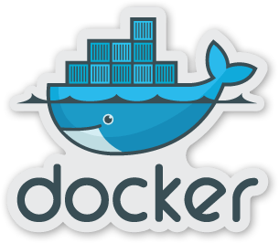
Todo alrededor de los contenedores es genial!!
Son ligeros
Adaptables
Portable
Contenedores y microservicios van de la mano
Notes:
Lightweight >> Containers are isolated but, unlike VMs, share OS and, where appropriate bins/libraries
Atomic, self-contained >> The container image encapsulates everything you need to run your application
Portable >> Can be run on any linux kernel, also on Windows in a repeatable way

Slide 4
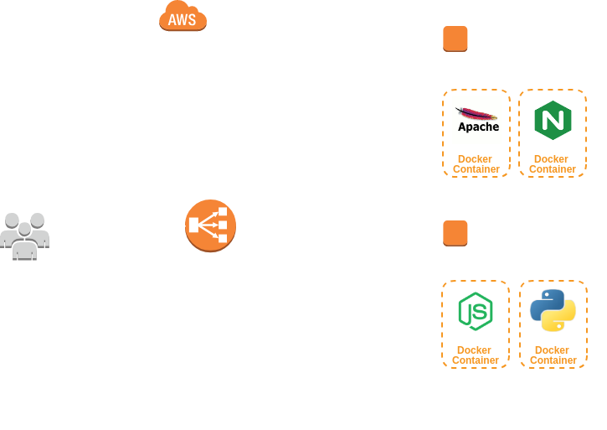
Entonces, si tengo un contendor corriendo en mi instancia ¿Como podrá escalar?
Notes:
You have to stich applications together
Apps are not made up of a single container
Apps are not handled by just one team
Apps need to be handled at scale

Slide 5
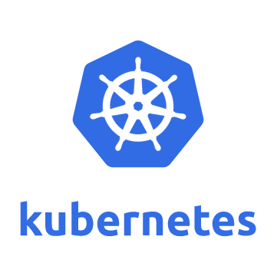
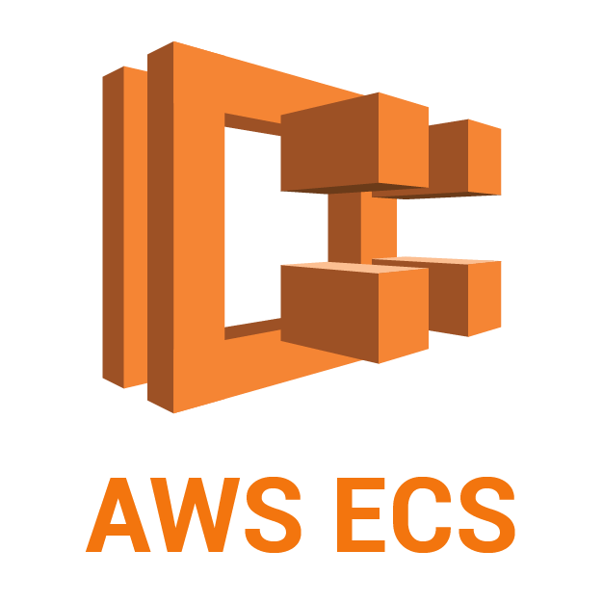
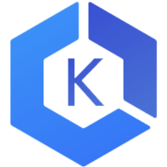
… y ¿Qué alternativas tenemos para la administración de contenedores en AWS?
Cómo puedo deployar mis contenedores sin afectar al servicio?
Sin downtime
Cómo puedo mantener mis contenedores siempre disponibles?
Programados, Restablecimiento
Cómo los contenedores pueden comunicarse entre ellos?
Servicio de enlazado, descubrimiento por red
Cómo puedo configurar mis contenedores en tiempo de ejecución?
Acceso vía consola y terminal
Cómo puedo hacer para optimizar el uso y cantidad de mis contenedores?
Ajuste de asociación de recursos mediante el monitoreo continuo, escalamiento de contenedores por demanda
AWS EKS
Notes:
You have to stich applications together
Apps are not made up of a single container
Apps are not handled by just one team
Apps need to be handled at scale

Slide 6


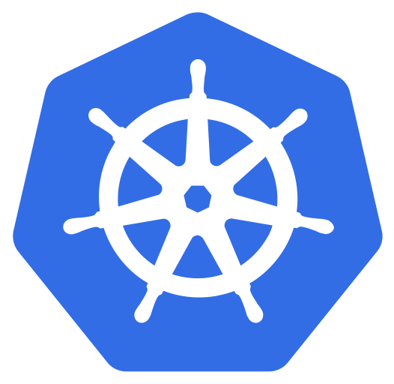

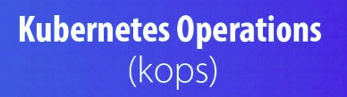
Nosotros podemos elegir:
ECS
EKS
Kubernetes Native
EC2
Fargate
EC2
Fargate
Notes:
Today we have 3 options and hopefully by end of the year customers will have 4. Talk through ECS, and differentiate EC2 and Fargate mode. Also cover EKS

Slide 7

Amazon EC2 Container Service (ECS)

Slide 8

Amazon EC2 Container Service (ECS)
Instancias: cada una se registra al cluster y corre sus Task aquí.
Servicios: esta capa gestiona y asigna las tareas.
Task: contenedor envuelve y configura los procesos corriendo dentro de la instancia.

Slide 9
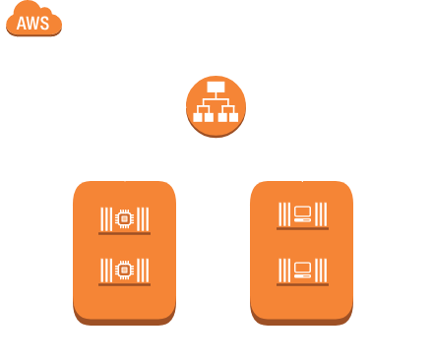
¿Cómo trabaja ECS?
Load Balancer: (ALB o ELB Classic) distribuyen el tráfico a los clusters.
Cluster: está hecho de una o más instancias EC2.
Cada Instancia de Cluster corre uno o más Servicios.

Slide 10

¿Qué ventajas tiene ALB sobre ELB?
Puedes definir reglas básicas para el direccionamiento del tráfico: Cuando dices enviar el tráfico a diferentes servicios basado en un endpoint, ¿no te parece genial?
Bonus: ALB permite asignar los puertos dinámicamente para la utilización de multi servicios.

Slide 11
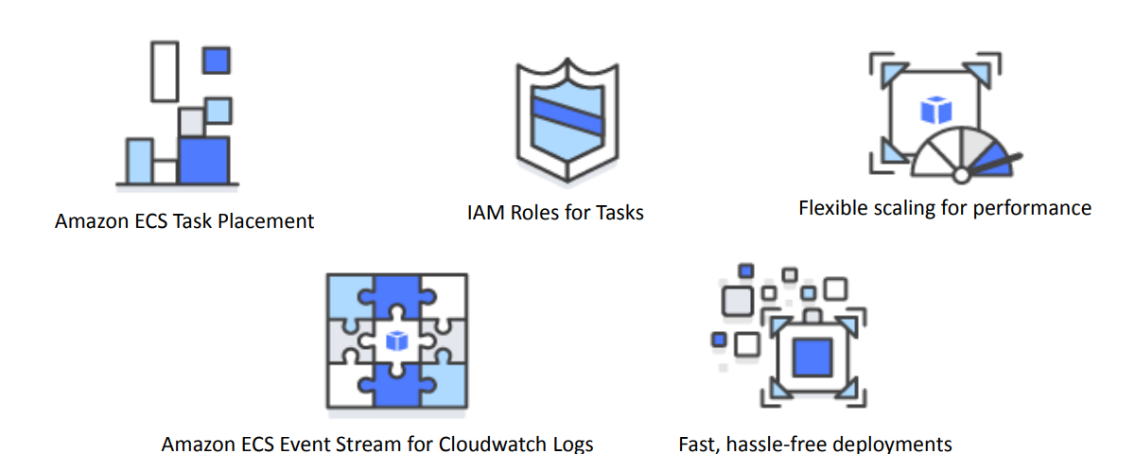
Algunas características...

Slide 12
Amazon ECS Task Placement
Un task placement strategy es un algoritmo para seleccionar las instancias y la colocación de las tareas o para el término de ellas.
un task placement constraint es una regla que se toma en consideración durante la colocación de la tarea.
un task placement strategy y un task placement constraint puede utilizarse en conjunto.

Slide 13
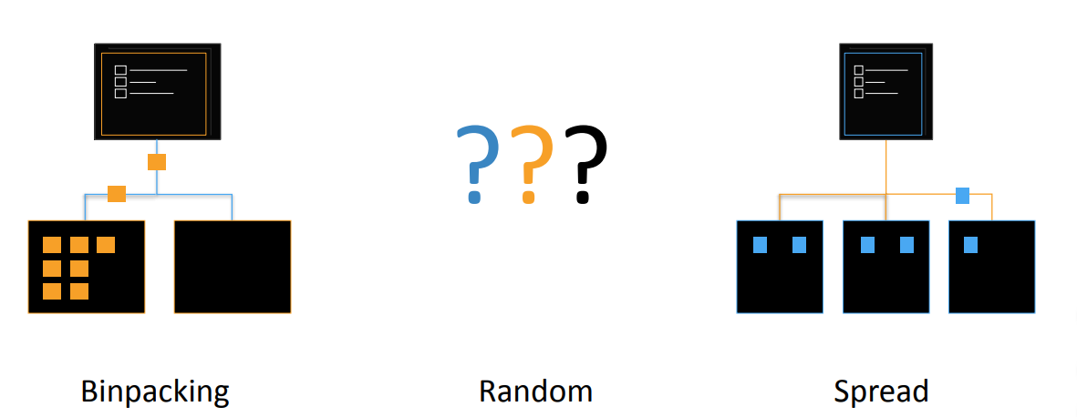
Multiple Strategies son soportadas

Slide 14
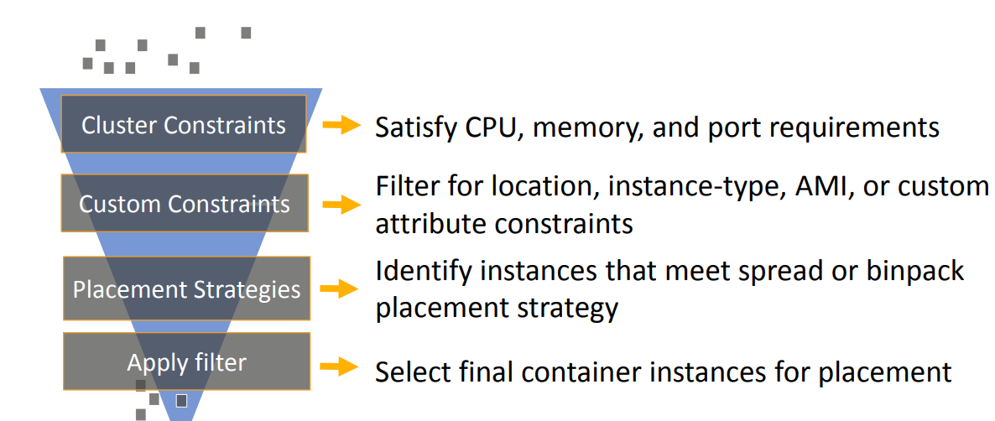
Como trabaja..

Slide 15

Amazon ECS Event Stream for Cloudwatch Logs
Recibe en tiempo real las actualizaciones sobre el estado actual de los contenedores.
Puedes programar acciones en base al estado del cluster generando eventos directamente en Lambda.

Slide 16

IAM Roles for ECS Tasks
Se especifica los roles por contenedores en las tareas.
Los contenedores pueden únicamente acceder al role que la tarea tenga asignada.
Autorización: los contenedores no pueden acceder a otras credenciales definidas para otras tareas.
Auditabilidad: Cloudtrail hace el trabajo por nosotros.

Slide 17
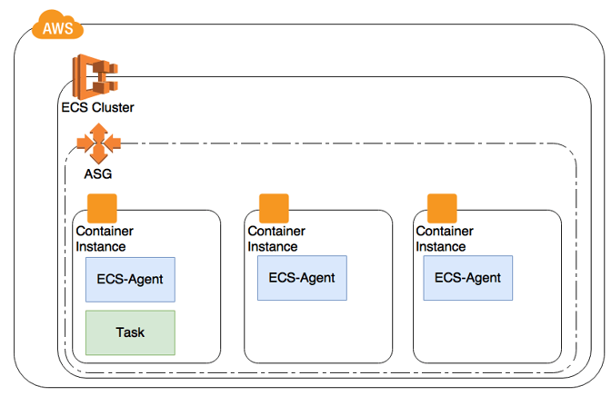
Flexibilidad de escalamiento
El escalamiento de los servicios están basado en las alarmas detectadas por cloudwatch.
EC2 Autoscaling Group nos ayuda a escalar nuestro cluster sin mayor inconveniente.

Slide 18
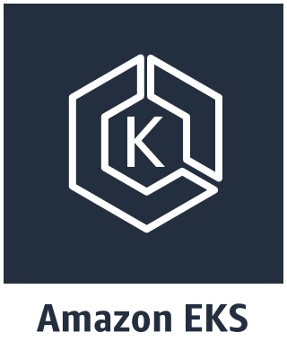
Kubernetes on AWS

Slide 19

Estadisticas...
57%
de las cargas de trabajo en Kubernetes se Ejecutar en AWS. — Cloud Native Computing Foundation
Notes:
Our customers believe that there are tremendous advantages to running Kubernetes on AWS. According to a CNCF survey this year, 57% of Kubernetes workloads run on AWS today. This is entirely organic growth fueled by strong community of developers, customers, and partners.
Let’s take a quick look at what your typical Kubernetes on AWS deployment looks like.

Slide 20
$ kubectl get tips –n meetup
Notes:
There is no Kubernetes construct for tips, this is just for representation of these slides.

Slide 21
GET api/v1/namespaces/meetup/tips/{1}
Nunca construir un cluster de kubernetes de la manera más difícil!
Notes:
Kubernetes the hard way Involves 14 different steps from creating master nodes, certificates, creating etcd, bootstrapping controllers and bootstrapping worker nodes etc.
Even Github page mentions to use the content for learning purpose only.

Slide 22
Opciones para configurar un cluster de Kubernetes en AWS.
Comunidad
Kops – kubernetes-aws.io
Kubeadm – Kit de Herramienta para arrancar los clusters
Kubespray – set de herramientas para deployar K8s clusters.
Enterprise
Elastic Container Service for Kubernetes (EKS)
Otras opciones
CloudFormation, Terraform, Ansible, Puppet
Notes:
Most well known community built tools for Kubernetes cluster setup and automation are Kops, Kubeadm, Kubespray
Kops: fully automates, manages and maintains Kubernetes cluster. You can roll prototype but also highly available production-grade cluster
Kubeadm: bootstraps existing instances with Kubernetes cluster configurations.
Kubespray: uses Ansible for provisioning and orchestration
Take an opportunity to mention how EKS differentiates among these offerings.
Openshift: not only manages Kubernetes environment but also offers better integration with Red Hat based toolsets

Slide 23

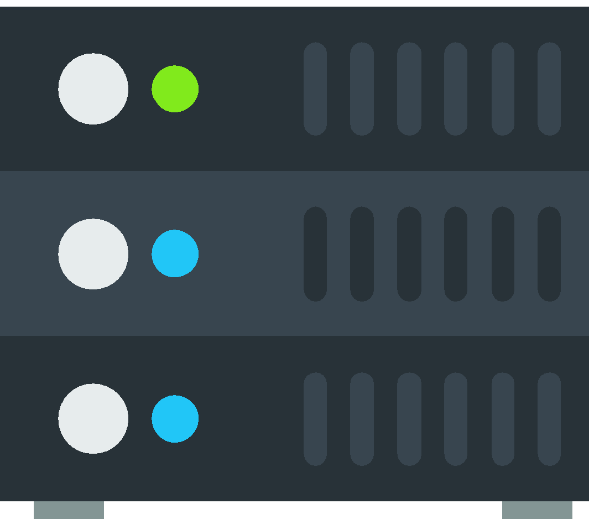

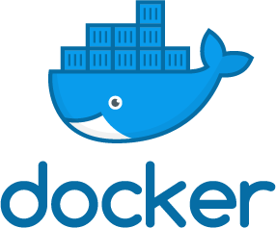

Kops
Puedes crearlo con Kops, pero la administración es tu responsabilidad.
Tus contenedores
Nodos Esclavos
Nodos Maestros
Almacenamiento del estado
Notes:
Slide credit – Nathan Peck/Brent Langston – Devoxx Kubernetes workshop
Kops helps your create those worker nodes, master, and etcd but all of that infrastructure is still your responsibility. If something goes wrong you are the one who gets paged to fix it, and you will be responsible for using kops to repair the cluster. This can get complicated quite quickly, for example you may need to scale up your etcd database to be able to handle more request volume as the cluster gets larger and the masters need to track the state of more instances and more applications running on those instances.

Slide 24


Slide 25
Responsabilidad basado en EKS con EC2
Tú
Amazon EKS
Tus contenedores
Nodos Esclavos
Nodos Maestros
Almacenamiento del estado
Notes:
Slide credit – Nathan Peck/Brent Langston – Devoxx Kubernetes workshop
Another option that will soon be available for people running Kubernetes on AWS is to use Amazon EKS as a managed control place. Amazon EKS provides you with secure, reliable, high availability Kubernetes masters, backed by high availability etcd. Everything is backed up and scaled by AWS, so if something goes wrong an AWS engineer gets paged and he or she is responsible for fixing it. The only thing you are responsible for is adding worker nodes for the masters to run containers, and providing your pod definitions to the masters to run on the worker nodes.

Slide 26
Manejo total de EKS
Tú
AWS Fargate
Amazon EKS
Tus contenedores
Nodos Esclavos
Nodos Maestros
Almacenamiento del estado
Notes:
Slide credit – Nathan Peck/Brent Langston – Devoxx Kubernetes workshop
Even managing worker nodes can get annoying. It can be challenging to know just how many worker nodes you need to run your desired number of pods. In 2018 we will release a fully managed approach where the Kubernetes masters are run by AWS, and you also don’t have to manage worker nodes. Instead you will have the option to utilize AWS Fargate. Fargate is our on-demand container platform. Just like EC2 made it easy to get a VM on-demand without having to worry about physical servers in a datacenter, Fargate makes it easy to run a container on-demand without even worrying about VM’s.

Slide 27


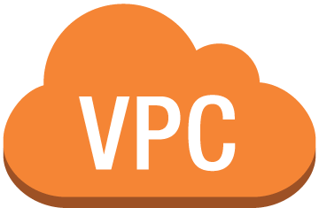

Amazon EKS
Kubectl
mycluster.eks.amazonaws.com
AZ 1
AZ 2
AZ 3
EKS Workers
Tu Cuenta AWS
Notes:
Now, with EKS, the complexity of standing up your own Kubernetes control plane is simplified. Instead of running the Kubernetes control plane in your account, you connect to a managed Kubernetes endpoint in the AWS cloud. This endpoint abstracts the complexity of the Kubernetes control plane- your worker nodes can check into a cluster, and you can interact with your Kubernetes cluster through the tooling you already know and love.

Slide 28
kubectl create namespace meetup
Notes:
I can create an isolation boundary for this application by simply defining new namespace.

Slide 29
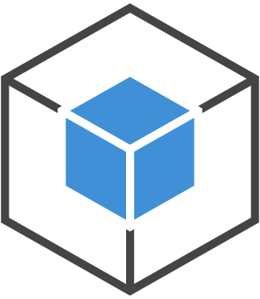
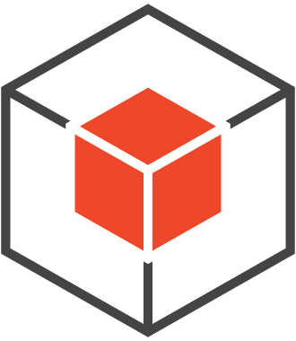
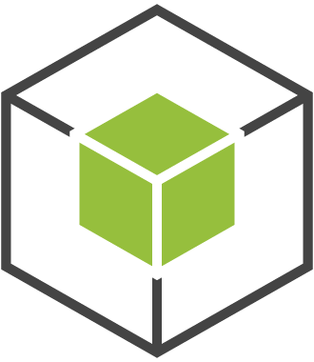
meetup-a-namespace
meetup-b-namespace
app-1
app-2
app-3
app-4
Frontend
Frontend
Notes:
Earlier I had dev namespace. I can create production namespace using ‘kubectl create namespace prod-namespace’ and control who has access to this environment so that I keep the blast radius to a minimal. Blast radius in terms of access control as well as resource usage can be defined at the namespace level

Slide 30
GET api/v1/namespaces/meetup/tips/{2}
Asegurar RBAC esté habilitado en tu Cluster
Notes:
Define RBAC
RBAC was introduced in 1.6 and got GA in 1.8. Now, its on by default.

Slide 31


EKS: IAM Autentificación + Kubectl
Pases de identidad AWS
1
Verificación de identidad AWS
4
2
K8s acción permitido/denegado
K8s API
Kubectl
3
AWS Auth
Autorización con RBAC en AWS
Notes:
Walk through how EKS uses IAM for Authentication as well as Kubernetes native-RBAC for Authorization
1) The Authenticator assists here with step 1. When a Kubectl call is made- let’s say I’ve made a get pods call, my IAM identity is passed along with the kubernetes call. We can look in the default credential chain for my IAM ID- aws config file, IAM role, etc.
2) On the backend, Kubernetes verifies the IAM identity with AWS auth. This is purely authentication.
3) The auth response is sent back to Kubernetes, and K8s checks it’s internal RBAC mapping for authz. This determines if my original get pods call was allowed or denied.
4) The K8s API approves or denies the request.

Slide 32
GET api/v1/namespaces/meetup/tips/{3}
Log y Monitoreo de todos los recursos!
Notes:
Logging and Monitoring is very important in Kubernetes

Slide 33
Visibilidad de tu Cluster Kubernetes
Logs
Metrics
Events
Alerts
Tracing
Cluster
Node
Container
Application
Notes:
And there are many things to log & monitor and lots of options available

Slide 34



Region
Logs
AZ1
Fluentd DaemonSet
ASG
ASG
Amazon CloudWatch Logs
Master
Worker
Worker
Kubectl logs
Amazon Elasticsearch
Service
AZ2
Master
Worker
Worker
Elasticsearch (index), Fluentd (store), and Kibana (visualize)
Kibana
Notes:
https://github.com/aws-samples/aws-workshop-for-kubernetes/tree/master/02-path-working-with-clusters/204-cluster-logging-with-EFK

Slide 35
Metricas
Visualizer
Grafana, Kibana, Dashboard
Alerting
AlertManager, Kapacitor
Cluster-wide Aggregator
Prometheus, metrics-server
Nodes Node exporter
Pod/Container
Kube-state-metrics
cAdvisor
Application
/metrics
JMX
Data Model
InfluxDB, Graphite
Notes:
In order to aggregate metrics, talk about node exporter, cAdvisor, metrics-server, Prometheus

Slide 36
GET api/v1/namespaces/meetup/tips/{4}
Opciones de escalamiento bajo demanda con Autoscaling
Notes:
Two ways to autoscale – Cluster and Pod level

Slide 37
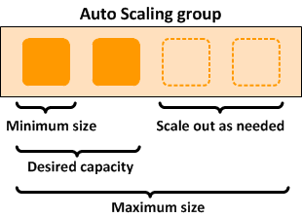
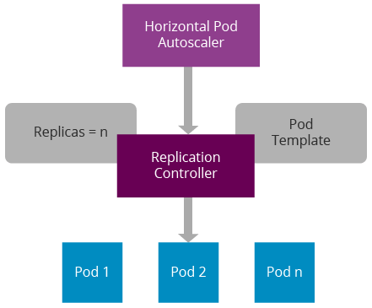
Alternativas de Autoscaling
Nativo Autoscaling de AWS
Autoscaler de k8s Cluster
Notes:
https://github.com/kubernetes/autoscaler/tree/master/cluster-autoscaler
Cluster autoscaler watches for pods failing and uses this to run additional worker nodes.
Pod priority and preemption: Configure high priority class for pods that are critical. Before this introduction in 1.11, Pod Disruption Budget (PDB) was considered before evicting pods but from now on, PDB will be best-effort

Slide 38
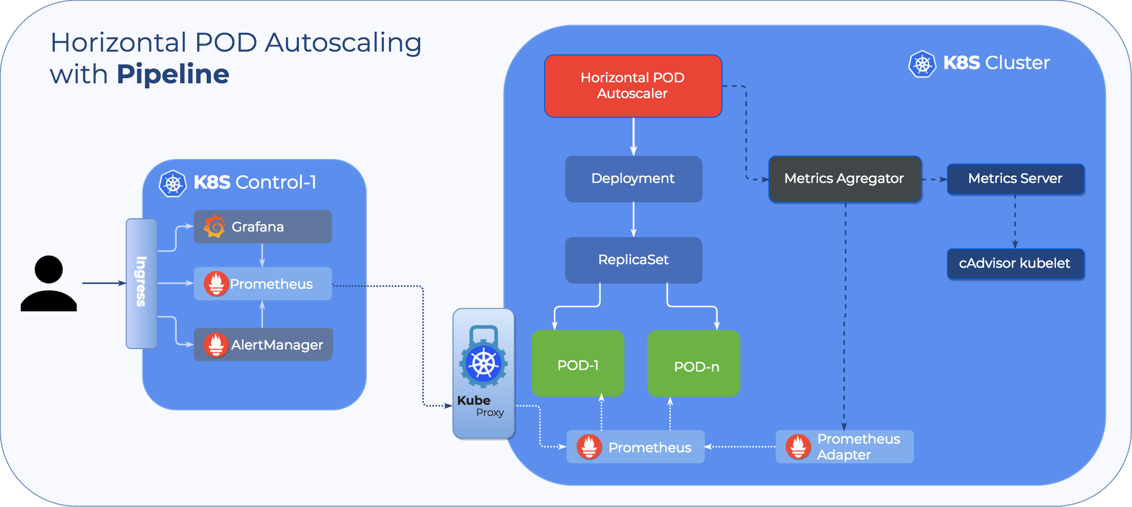
HPA k8s Cluster
Notes:
https://kubernetes.io/docs/tasks/run-application/horizontal-pod-autoscale/
HPA can be applied at Replicasets or Deployment.

Slide 39
GET api/v1/namespaces/meetup/tips/{5}
Construir, Enviar, Desplegar …

Slide 40
CI/CD de aplicaciones dentro de Kubernetes
Jenkins
AWS CodePipeline, AWS CodeCommit, AWS CodeBuild
OSS: Spinnaker, Skaffold
AWS partners
GitLab
Shippable
CircleCI
Codeship
Notes:
Tons of options here for Kubernetes.

Slide 41
Es momento de...

Slide 42
Premiar a nuestros participantes!!

Slide 43
Problema N°1 - ECS
1.- Si quiero especificar la instancia en donde se deberá desplegar mi contenedor, ¿Qué tipo de Placement Strategy debería utilizar para lograrlo?
¿?

Slide 44
Problema N°2 - Kubernetes
2.- Quiero obtener los logs de mis aplicaciones corriendo en mi cluster y además los logs generados por el mismo cluster con el objetivo de visualizarlos posteriormente en Kibana, en base a la sección de logs presentada, como se llama el Data Collector que corre como un DaemonSet dentro de Kubernetes para la recolección de los logs?
¿?

Slide 45
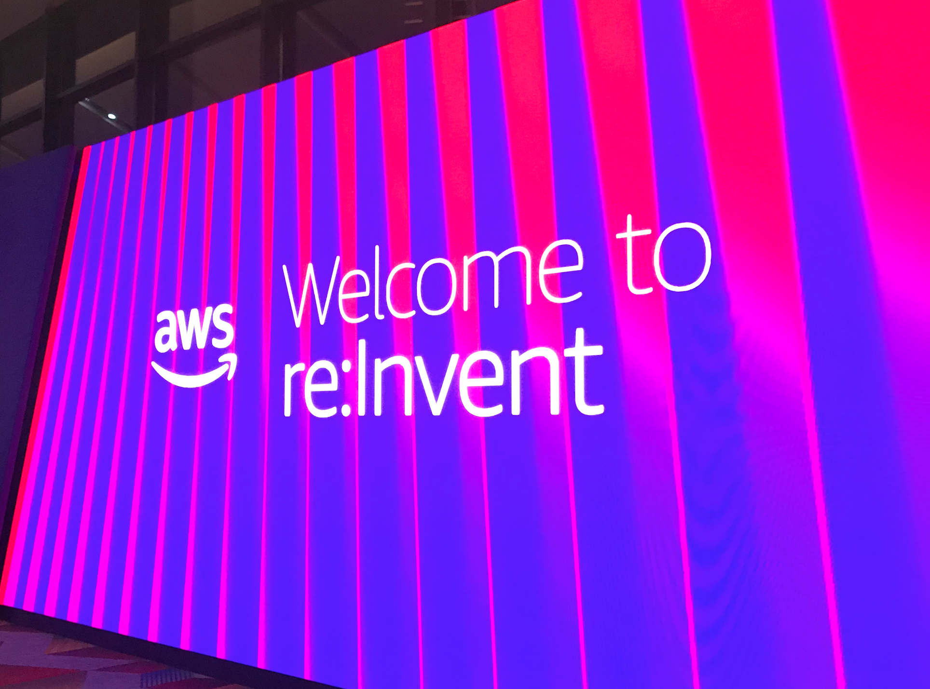
re:Invent Recap

Slide 46
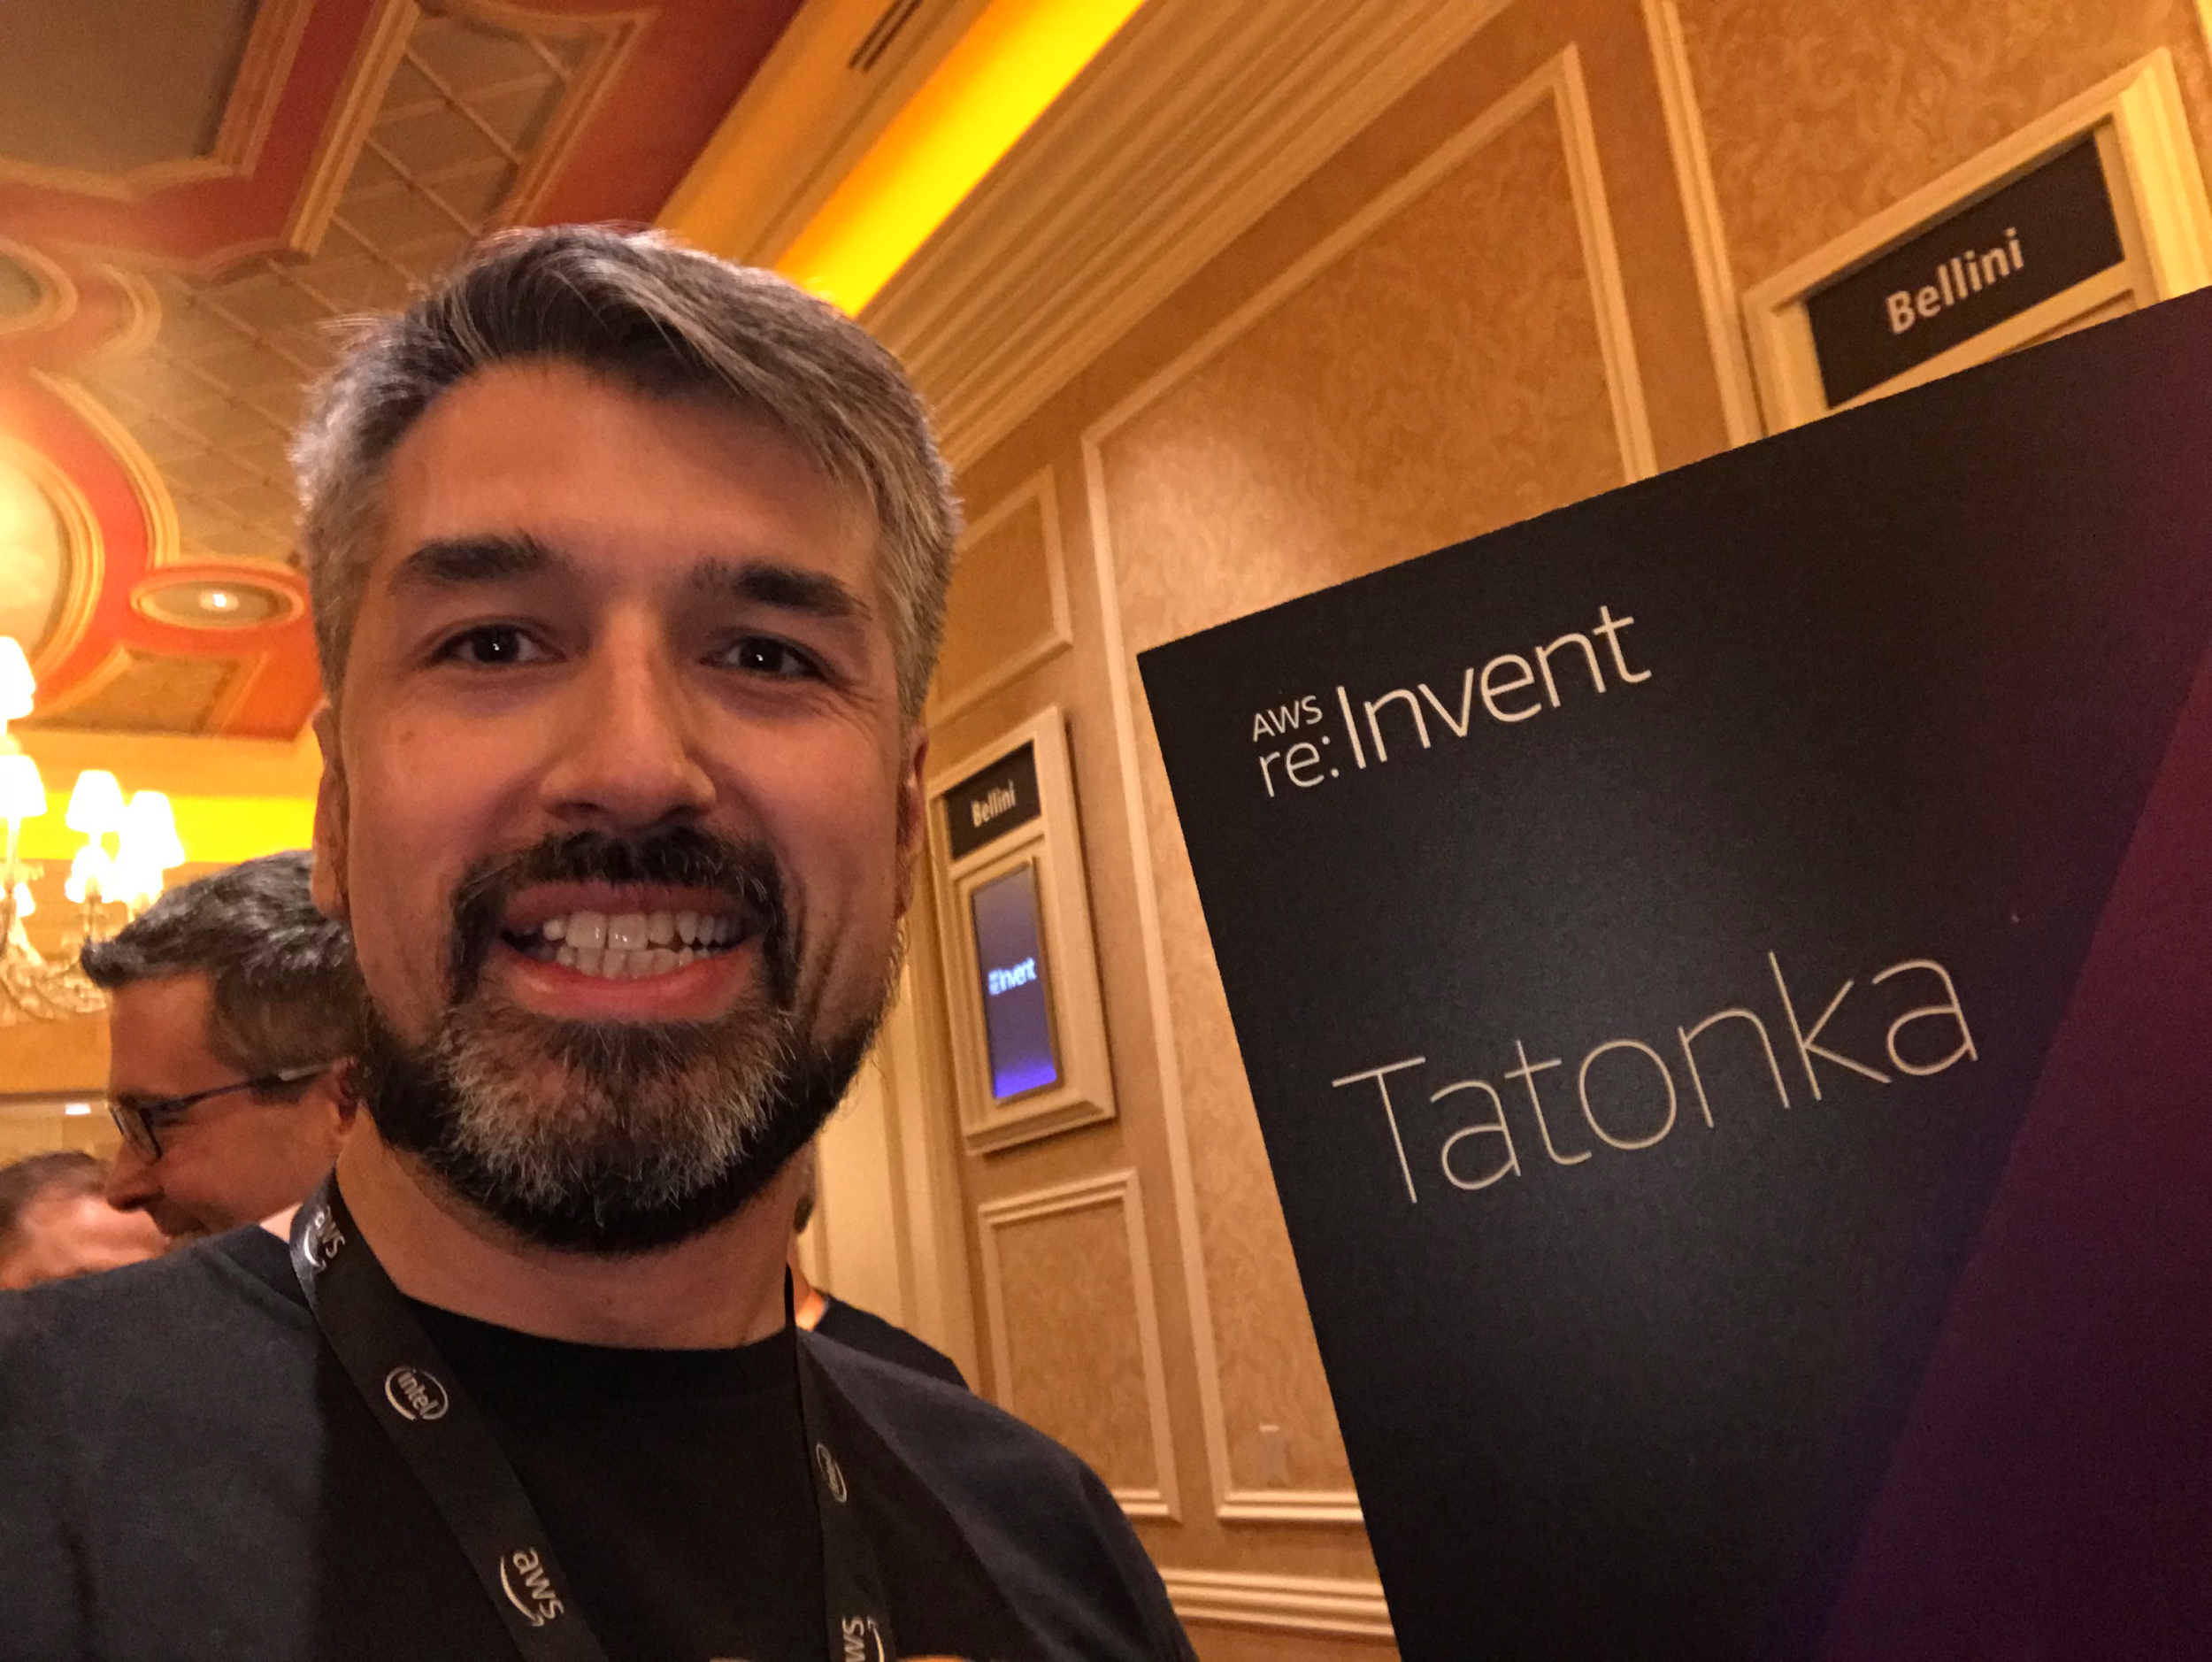

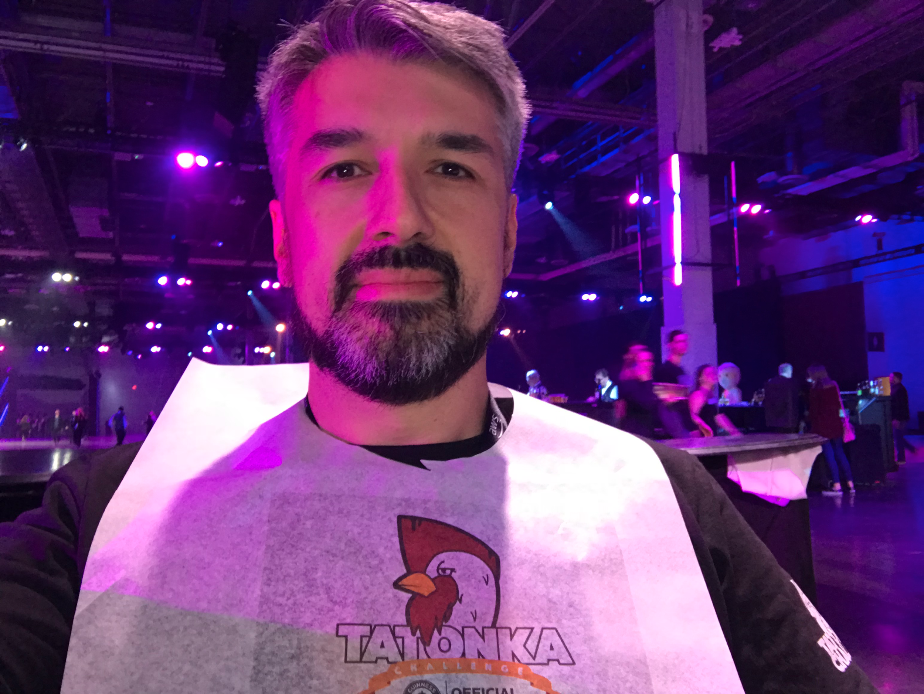
Calentando motores

Slide 47

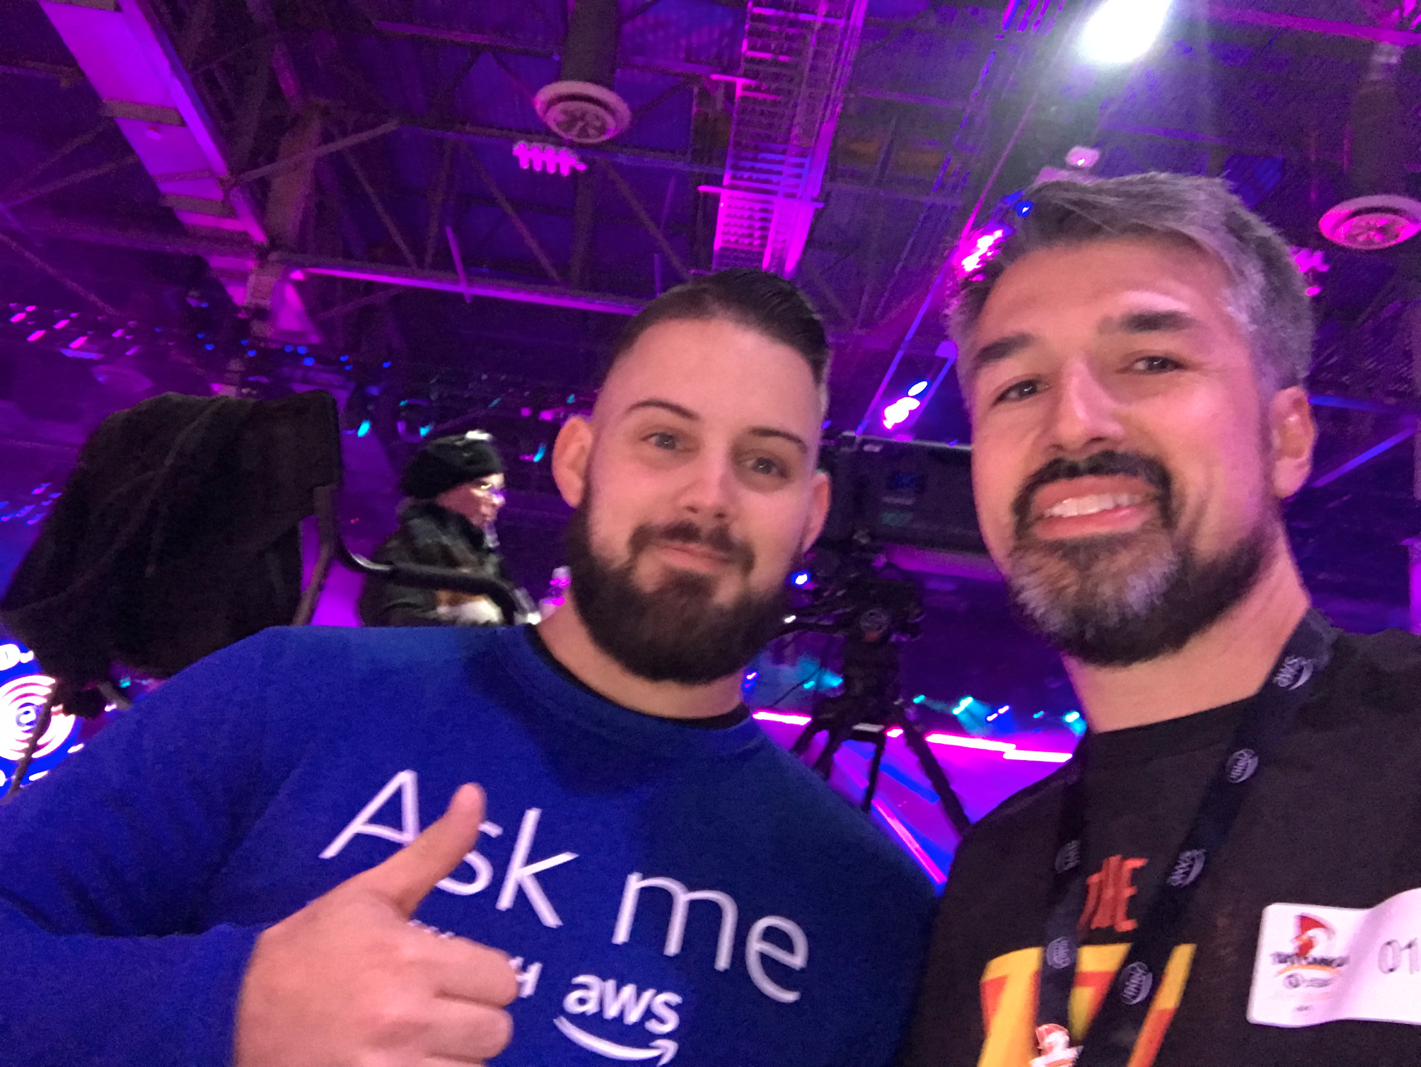
Midnight Madness

Slide 48
Launches, Preview & Pre-Announcements
https://aws.amazon.com/es/new/reinvent/
AWS Robomaker
AWS DataSync
AWS Transfer for SFTP
S3 Intelligent-Tiering
S3 Batch Operations
Snowball Edge Compute Optimized
AWS Amplify Console
AWS Global Accelerator
AWS Transit Gateway
Amazon EC2 A1 Instances
Amazon EC2 C5n Instances
Amazon EC2 P3dn instances
Elastic Fabric Adapter
Dynamic Training with Apache MXNet on AWS
Amazon Sagemaker Neo
Firecracker
KMS Custom Key Store
AWS IoT SiteWise
Amazon EBS Doubles Max

Slide 49
Launches, Preview & Pre-Announcements
https://aws.amazon.com/es/new/reinvent/
Performance of io1 Volumes
AWS IoT Events
AWS IoT Things Graph
S3 Object Lock
Private Marketplace
AWS Marketplace for Containers
Amazon Comprehend Medical
AWS Ground Station
ML Insights for QuickSight
Dashboard embedding in Amazon QuickSight
DynamoDB transactions
AWS Elemental MediaConnect
S3 PUT to Glacier
CodeDeploy Blue/Green Deployment Support for ECS
CodePipeline: ECR as a source action
Amazon Kinesis Data Analytics for Java applications

Slide 50
Launches, Preview & Pre-Announcements
https://aws.amazon.com/es/new/reinvent/
CloudWatch Logs Insights
Amazon S3 Glacier Deep Archive
Amazon FSx for Windows File Server
Amazon FSx for Lusre
AWS Control Tower
AWS Security Hub
Amazon Lake Formation
DynamoDB On-Demand
Amazon Timestream
Amazon Quantum Ledger Database
Amazon Managed Blockchain
Amazon Elastic Inference
AWS Inferentia
Amazon Sagemaker Ground Truth
AWS Marketplace for ML
Amazon Sagemaker RL
AWS DeepRacer
Amazon Textract
Amazon Personalize

Slide 51
Launches, Preview & Pre-Announcements
https://aws.amazon.com/es/new/reinvent/
AWS Well-Architected Tool
Amazon Forecast
AWS Outposts
EFS Multi-VPC Access
Amazon RDS on VMware
On-Demand Hibernated
AWS Cloud Map
AWS App Mesh
Pre-built scikit-learn container
AWS License Manager
Custom Runtimes for Lambda
Ruby support for Lambda
Lambda Layers
Nested Applications using Serverless Application Repository
Step Functions service integrations
WebSocket support for API Gateway
ALB Support for Lambda
Amazon Managed Streaming for Kafka

Slide 52
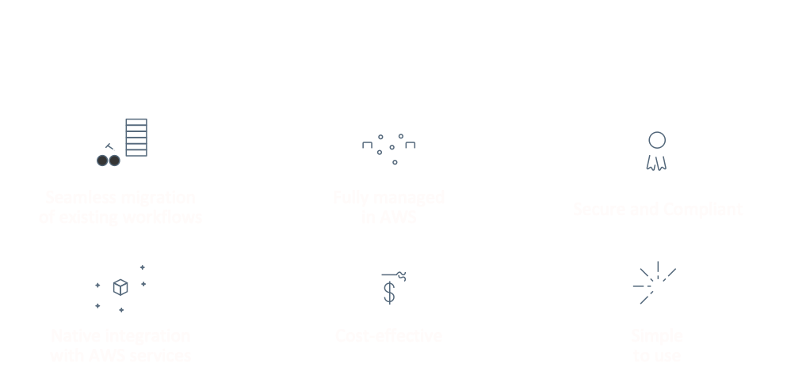

Slide 53


Slide 54


Slide 55


Slide 56

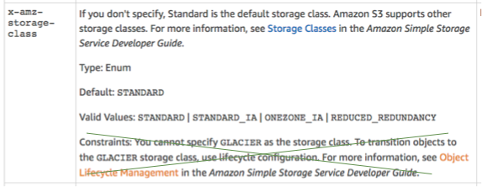

Slide 57


Slide 58
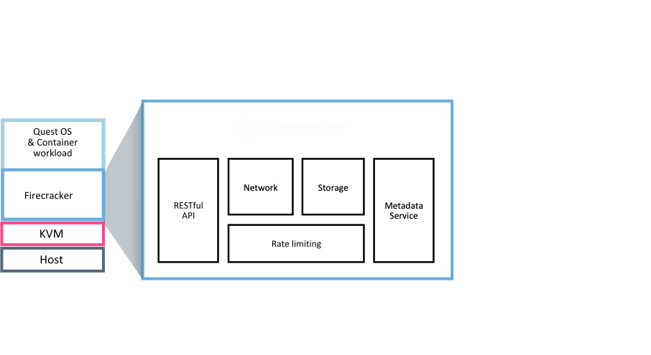

Slide 59


Slide 60




Slide 61



Slide 62

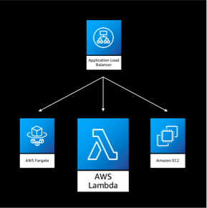

Slide 63

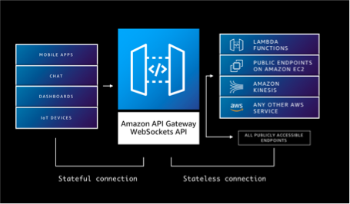

Slide 64
Introducing AWS RoboMaker
https://twitter.com/awsreinvent/status/1066966596546060289

Slide 65
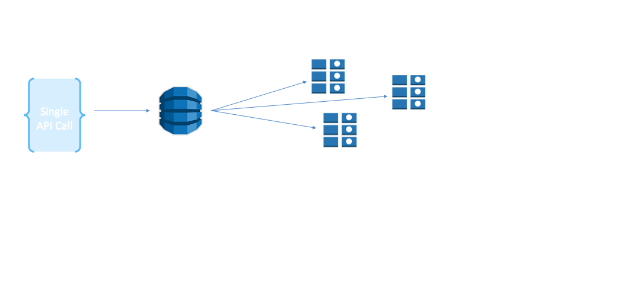

Slide 66
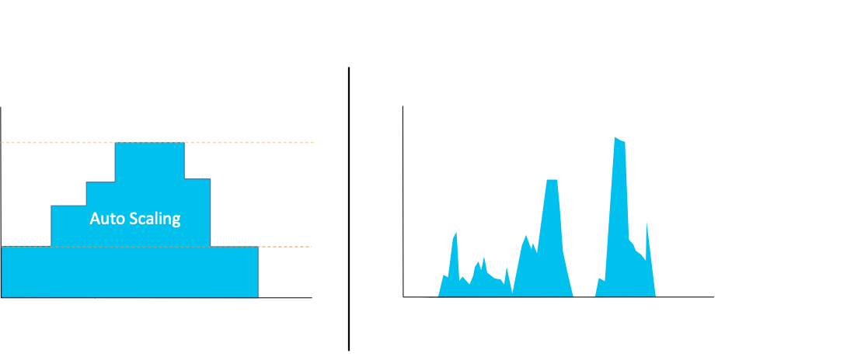

Slide 67
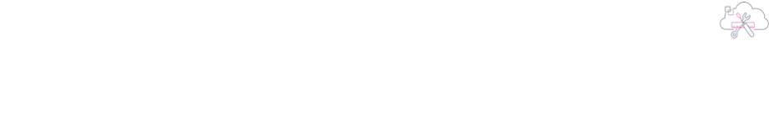


Slide 68
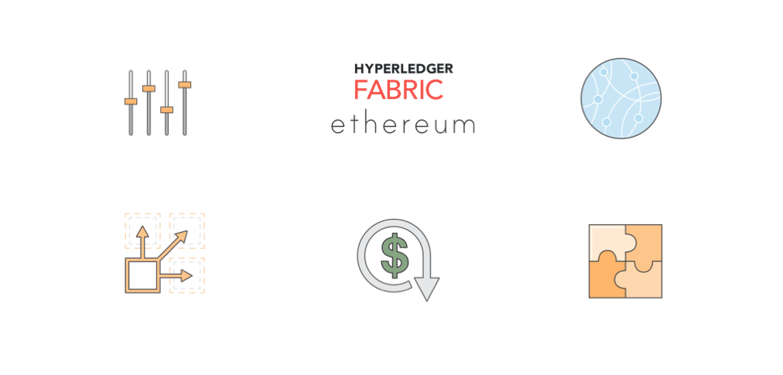

Slide 69

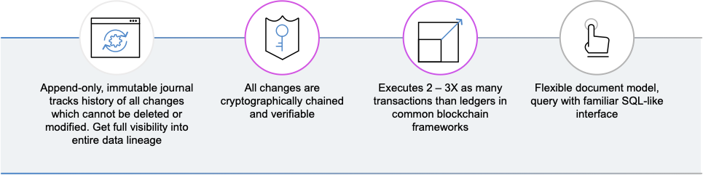

Slide 70
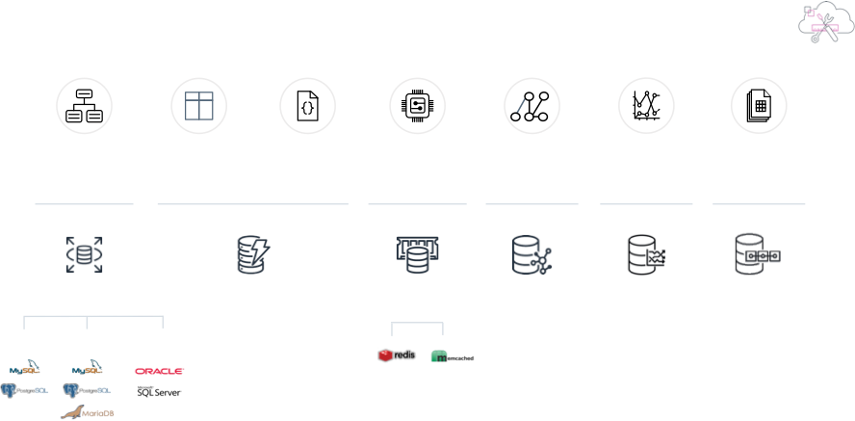

Slide 71
Para conversar
Amazon Lake Formation
AWS DeepRacer
AWS Well-Architected Tool

Slide 72
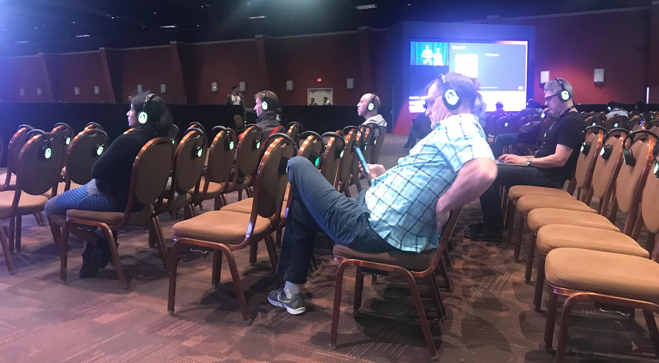

Eventos múltiples

Slide 73
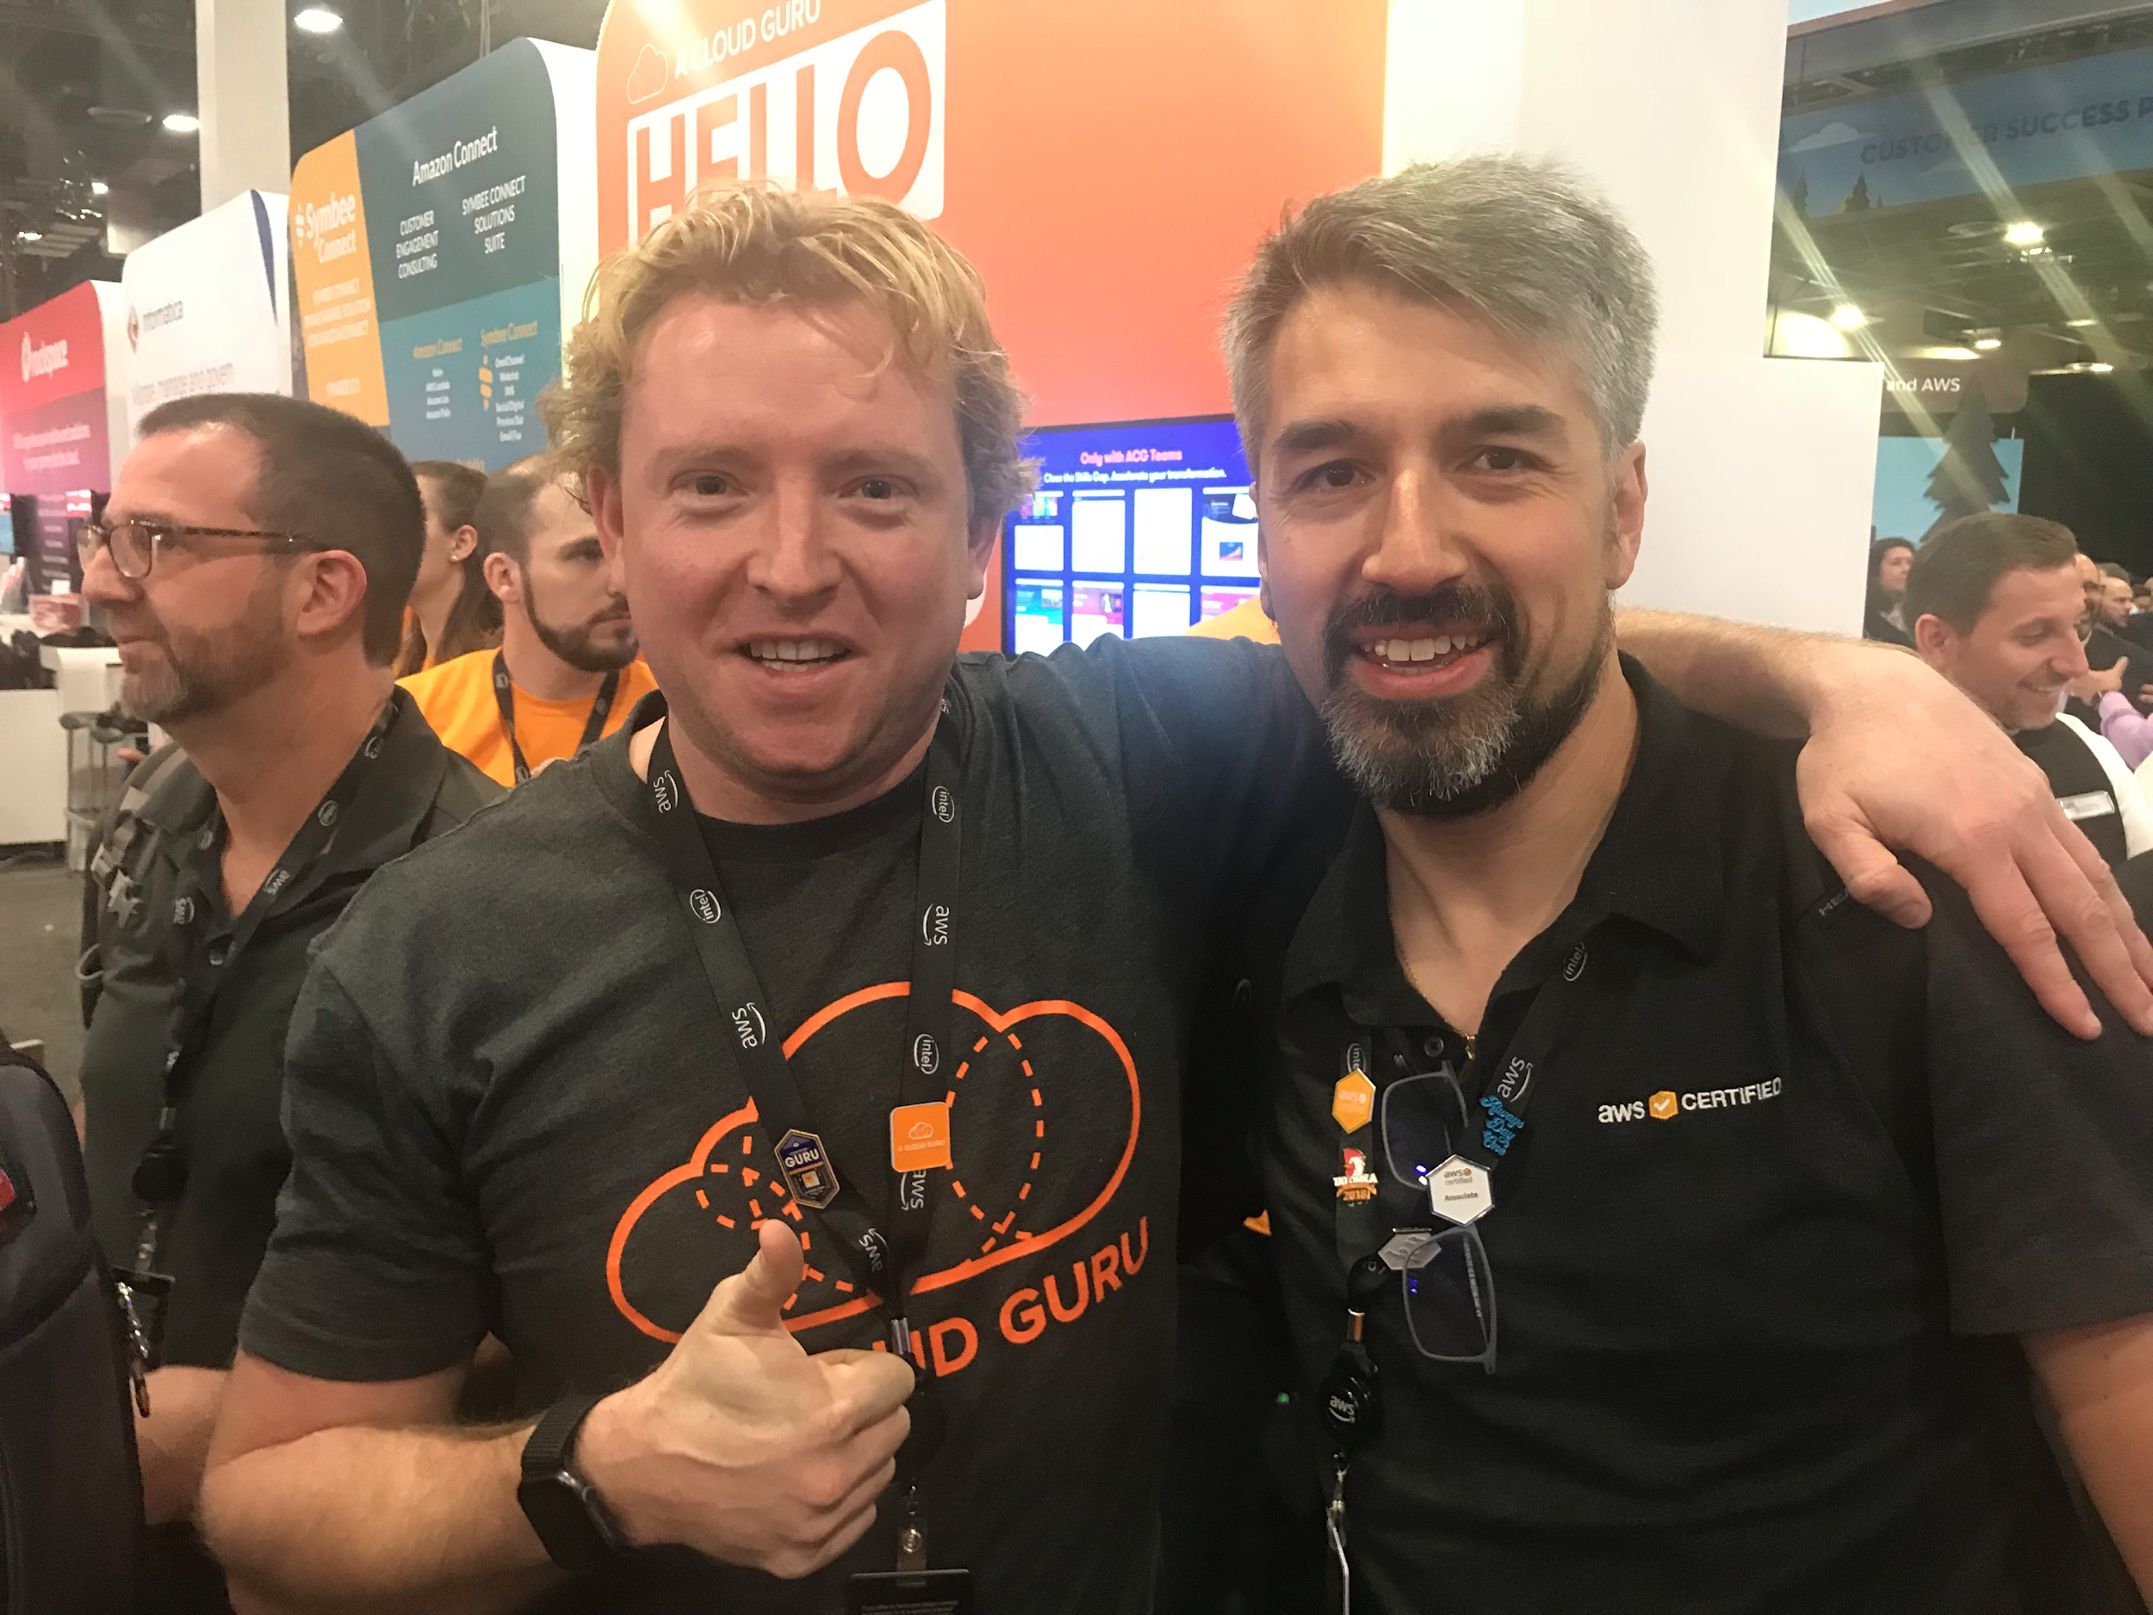
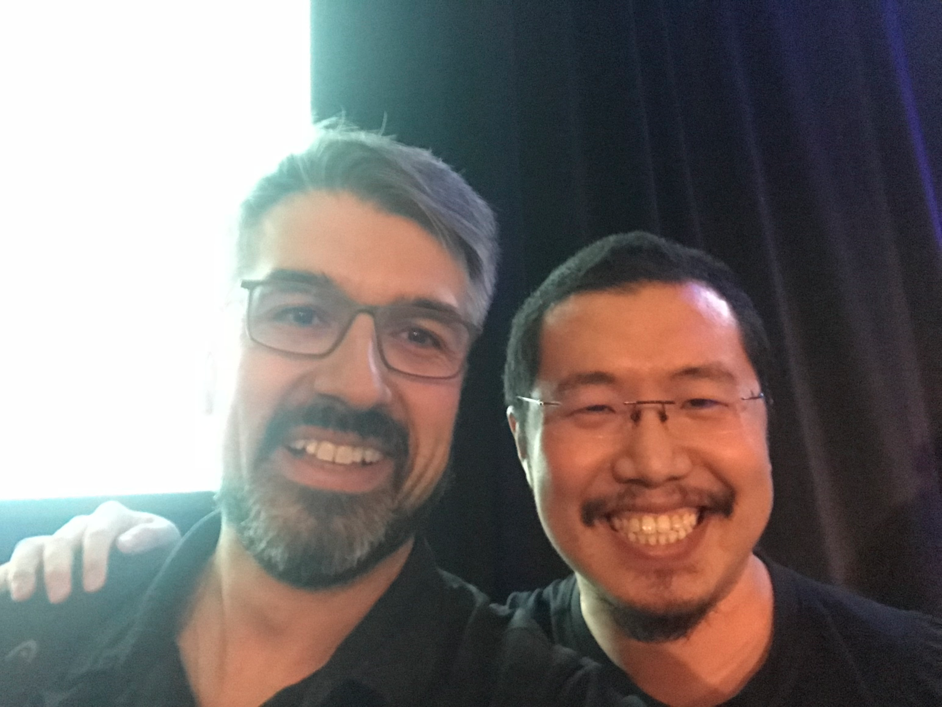
Personajes
AWS Serverless Hero @theburningmonk
A Cloud Guru Founder
@KroonenburgRyan

Slide 74
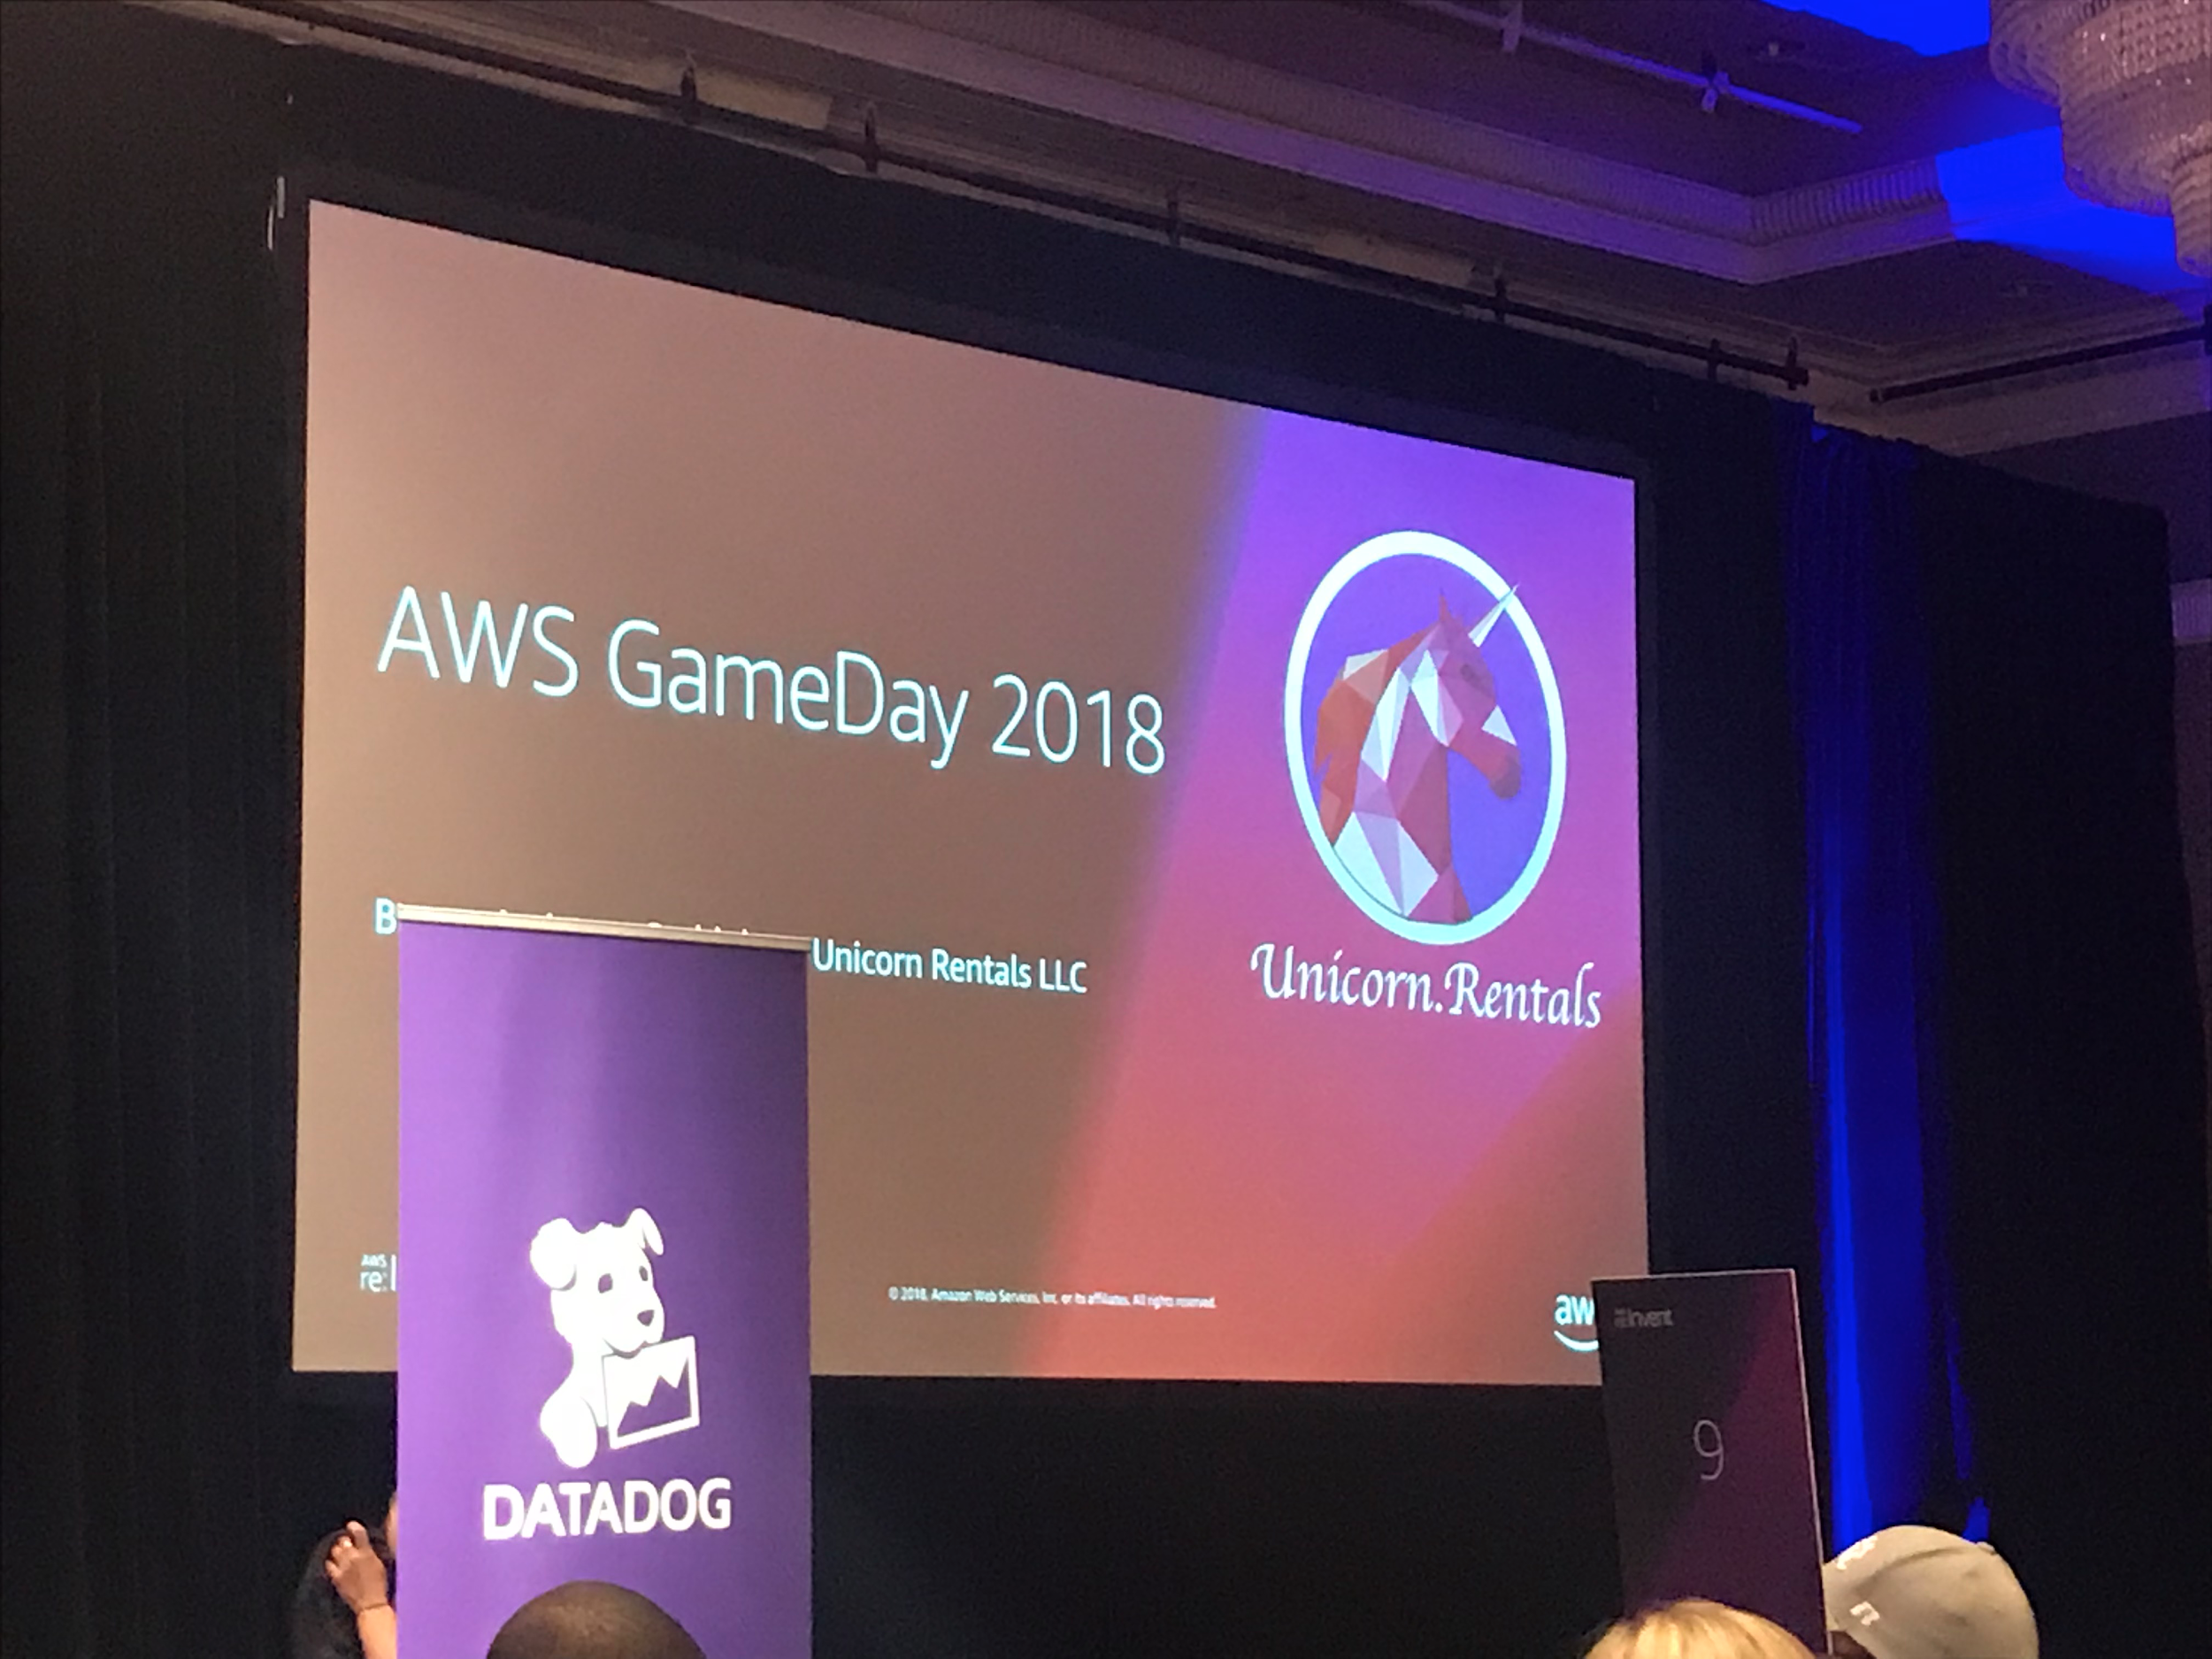
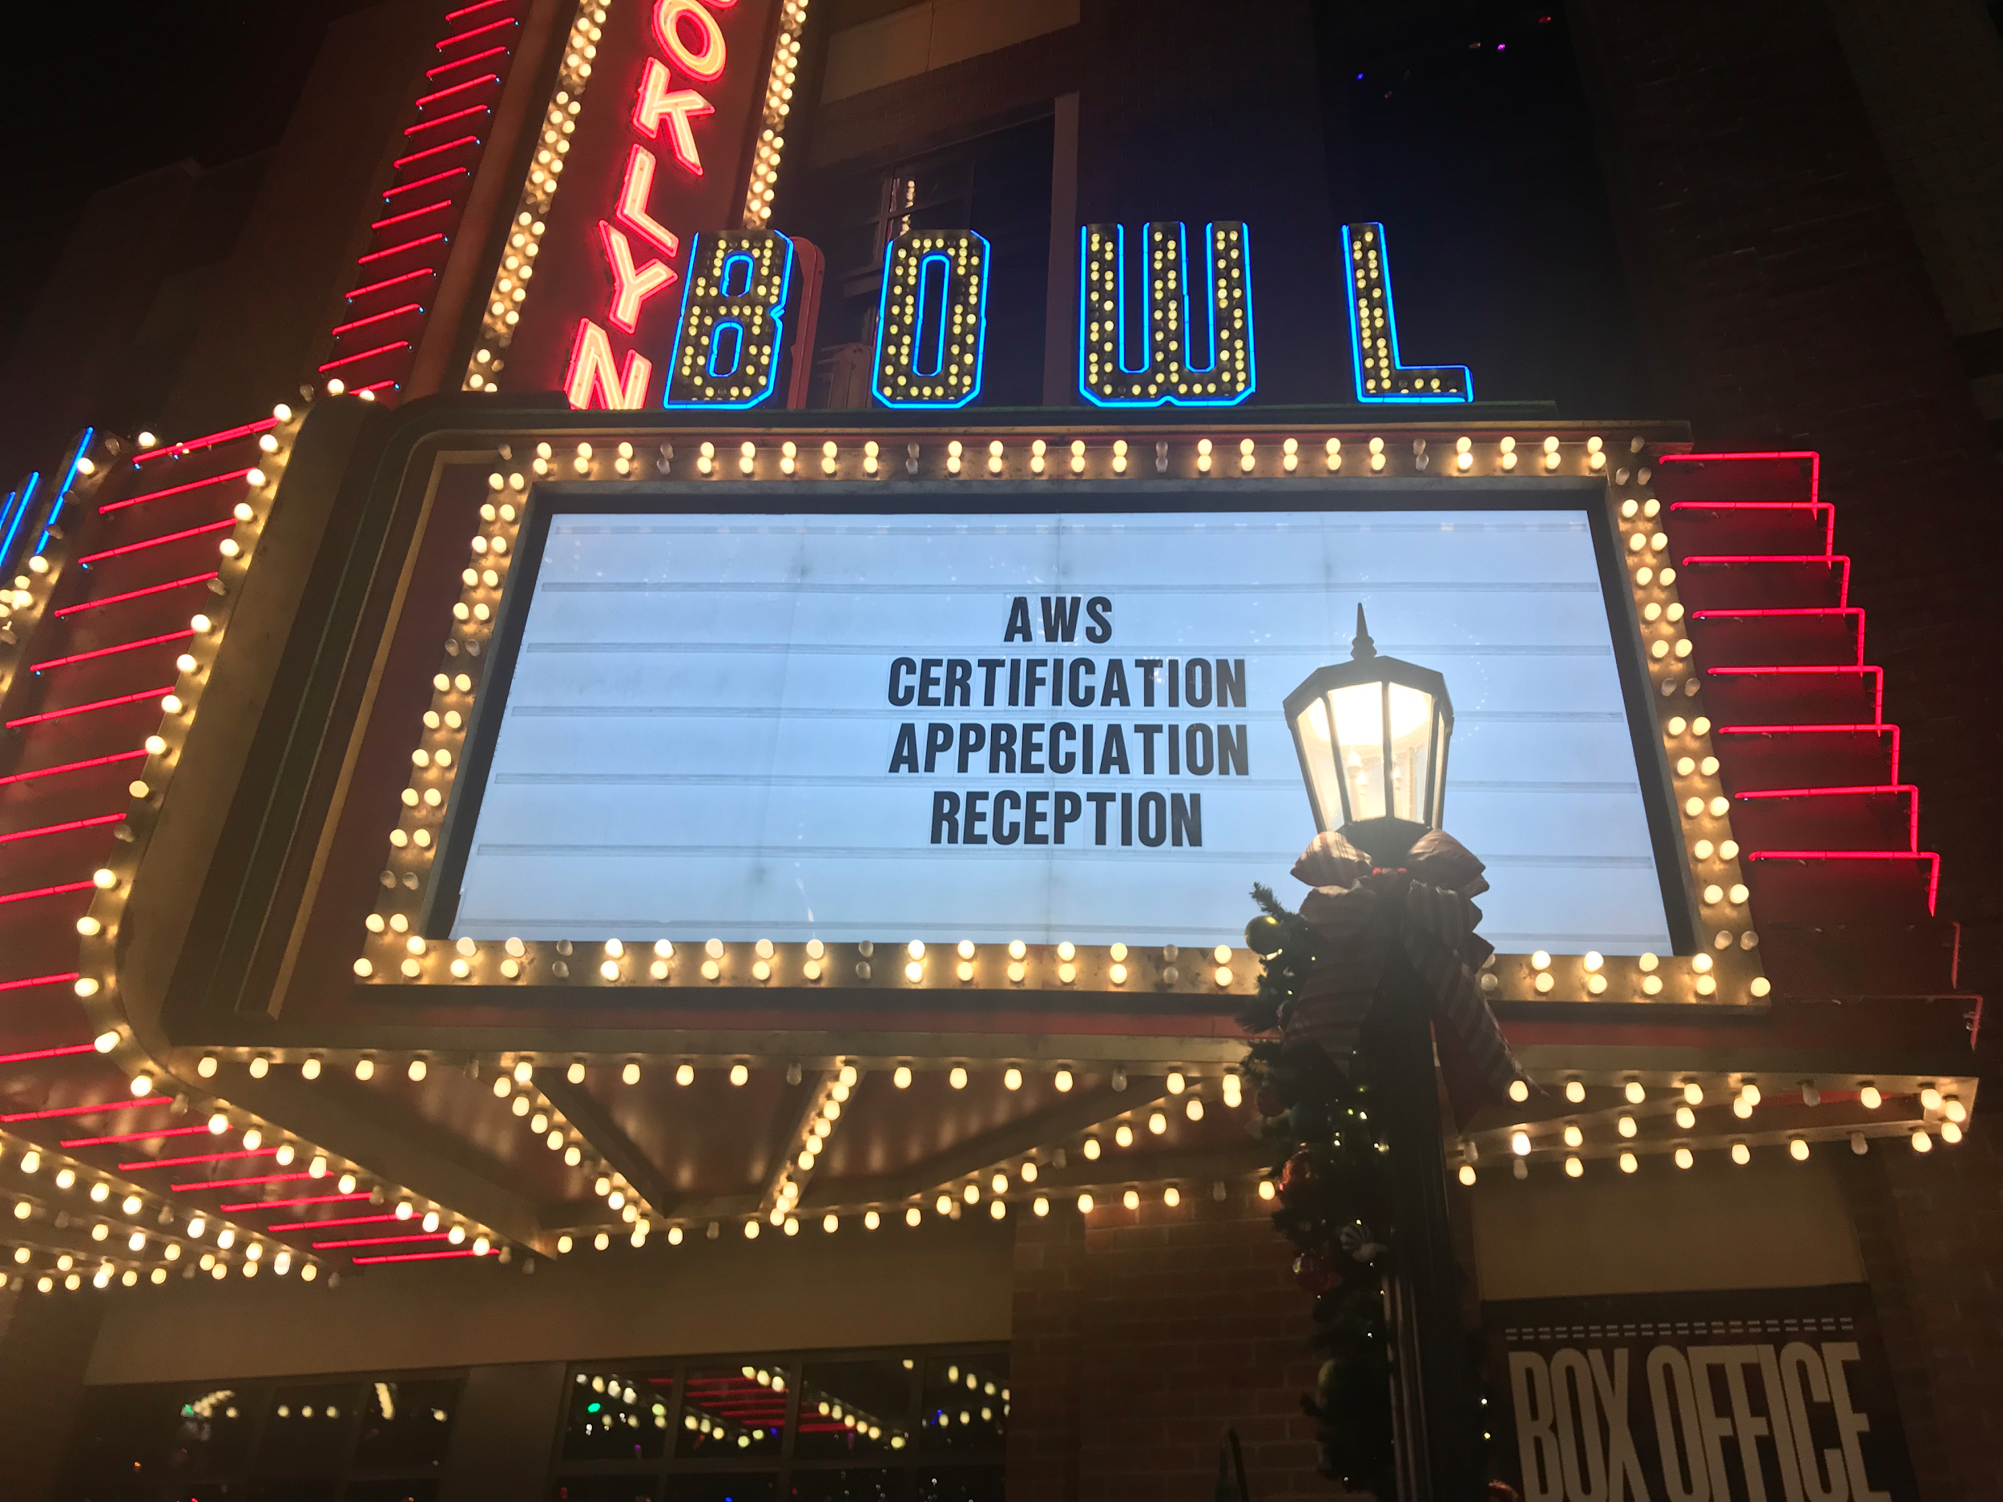
Highlights

Slide 75
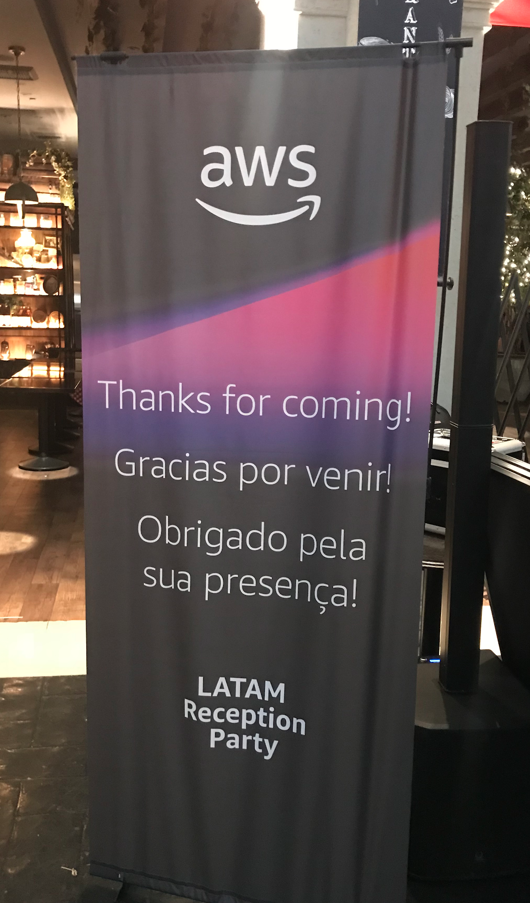
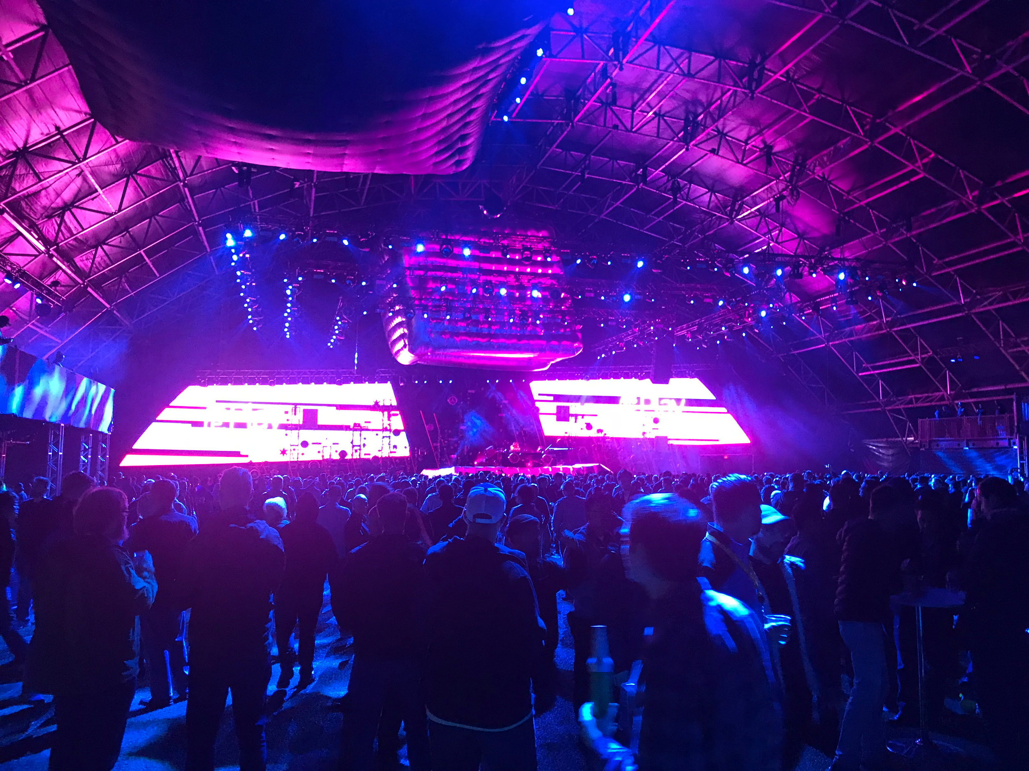
Highlights

Slide 76
Gracias!
e.miranda@globant.com
gvasquez@waypoint.cl

